Slide 1
Spam Detection Classifier
Prepared by
SARTHAK GUPTA

Slide 2
Agenda
Introduction​
Problem Statement
Business Goal
Technical Requirement
Exploratory Data Analysis (EDA)
Data Description
Visualization
Data Pre- Processing
Build Model
Saved Best Model
Summary​

Slide 3
Introduction
With the covid SMS Spam Collection is a set of SMS tagged messages that have been collected for SMS Spam research. It contains one set of SMS messages in English of 5,574 messages, tagged according being ham (legitimate) or spam.
Spam Detector is used to detect unwanted, malicious and virus infected texts and helps to separate them from the non-spam texts. It uses a binary type of classification containing the labels such as ‘ham’ (non-spam) and spam. Application of this can be seen in Google Mail (GMAIL) where it segregates the spam emails in order to prevent them from getting into the user’s inbox.
A collection of 5573 rows SMS spam messages was manually extracted from the Grumble text Web site. This is a UK forum in which cell phone users make public claims about SMS spam messages, most of them without reporting the very spam message received. The identification of the text of spam messages in the claims is a very hard and time-consuming task, and it involved carefully scanning hundreds of web pages.

Slide 4
Business Goal
A subset of 3,375 SMS randomly chosen ham messages of the NUS SMS Corpus (NSC), which is a dataset of about 10,000 legitimate messages collected for research at the Department of Computer Science at the National University of Singapore.
The messages largely originate from Singaporeans and mostly from students attending the University. These messages were collected from volunteers who were made aware that their contributions were going to be made publicly available.

Slide 5
Technical Requirements
We have We need to build a machine learning model. But before model building do all data preprocessing steps involving NLP. Try different models with different hyper parameters and select the best model.
Follow the complete life cycle of data science. Include all the steps like:
Data Cleaning
Exploratory Data Analysis
Data Preprocessing
Model Building
Model Evaluation
Selecting the best mode

Slide 6
EDA
Checked Top 5 rows of dataset
Checked Total Numbers of Rows and Column
Checked All Column Name
Checked Data Type of All Data
Checked for Null Values of both dataset
Checked total number of unique value
Checked Information about Data
Dropped irrelevant features
Handled NULL values
Handled duplicate values

Slide 7


Data Description
The dataset contains 5572 records (rows) and 5 features (columns).
And after removal of irrelevant data and column, we remains with 5169 records (rows) and 6 features (columns).

Slide 8
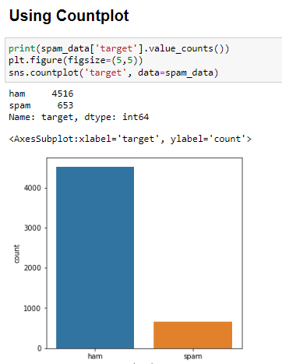
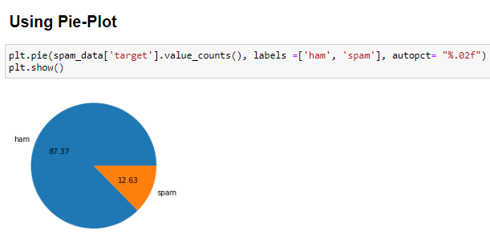
Data Visualization

Slide 9
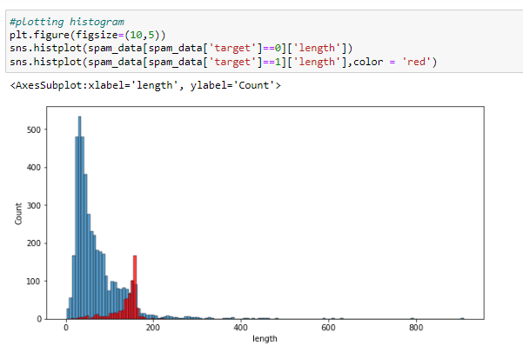
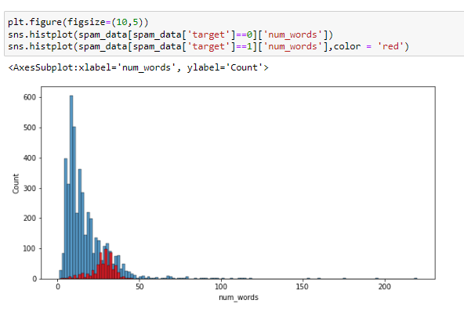
Data Visualization

Slide 10
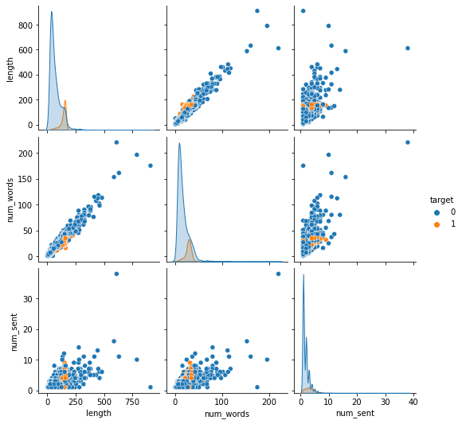

Data Visualization
Multivariate Analysis using Pairplot.

Slide 11
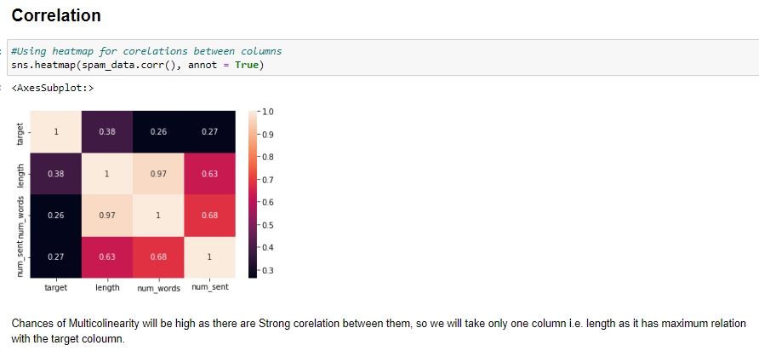
Co-Relation

Slide 12
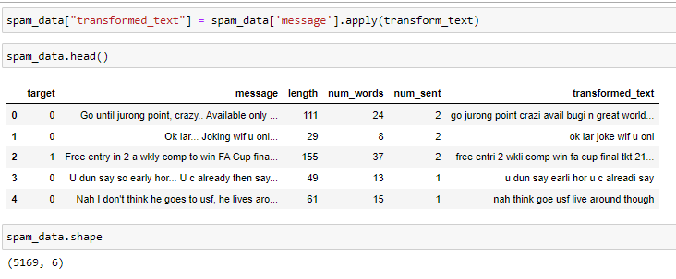
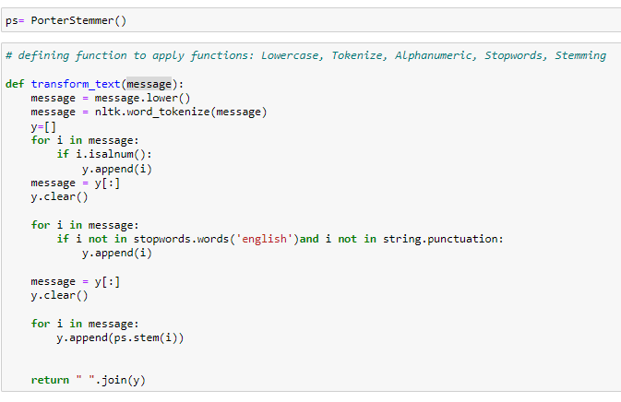
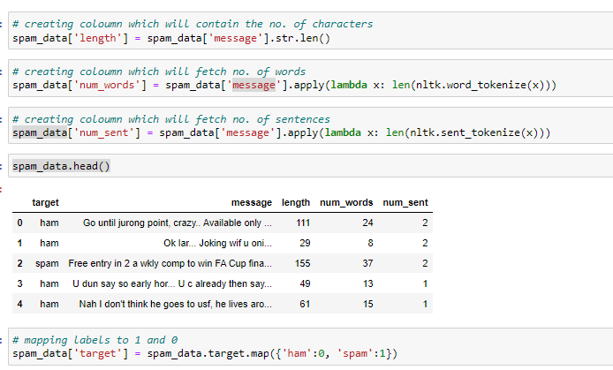
Data Pre- Processing

Slide 13
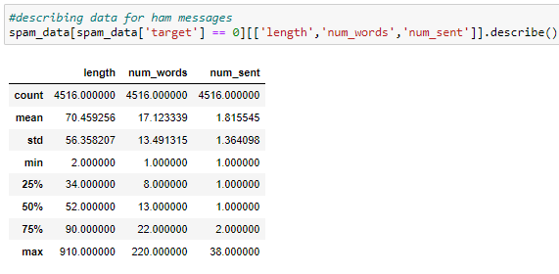
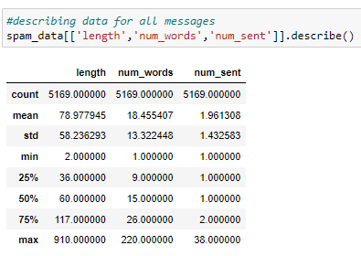
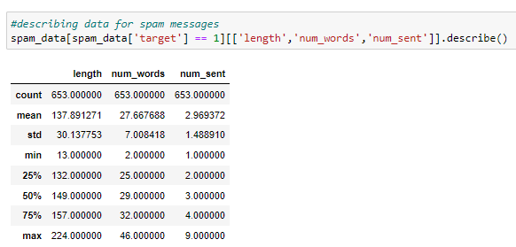
Data Describing

Slide 14
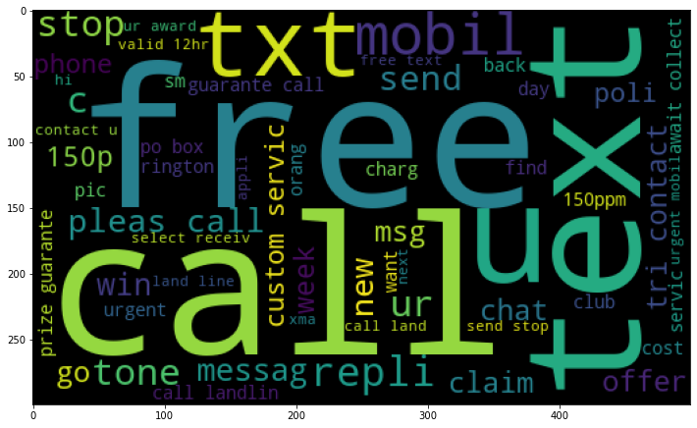
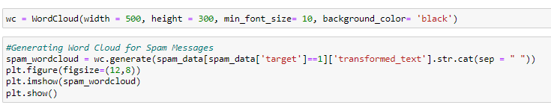
Word Cloud

Slide 15
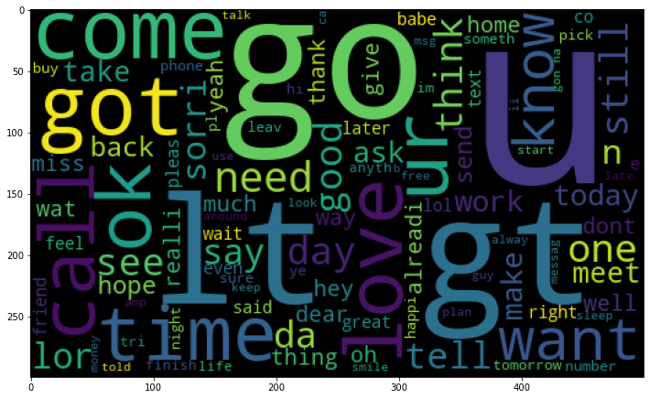

Word Cloud

Slide 16
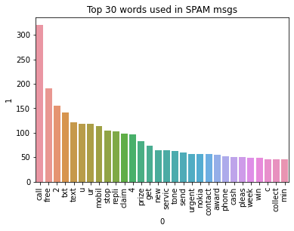


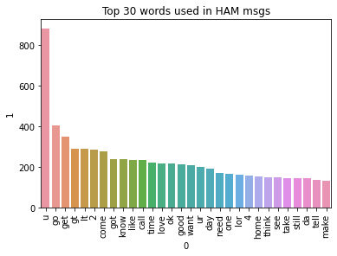
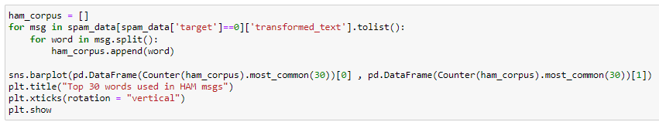
Word Cloud

Slide 17
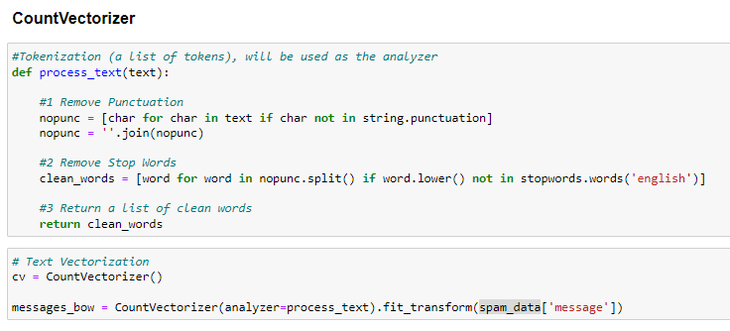
Word Cloud

Slide 18
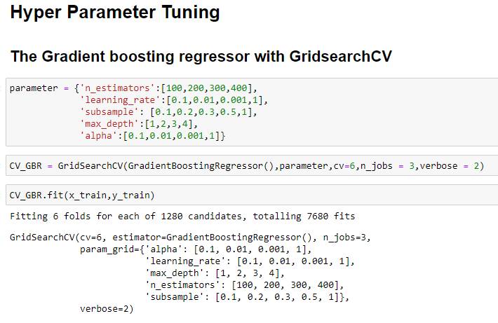
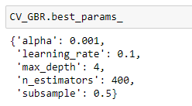
Hyper Parameter Tunning

Slide 19

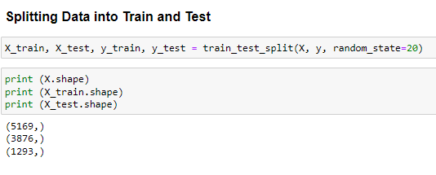
Algorithms Testing
Logistic Regression
Linear Support Vector Classifier
Bernoulli NB
Multinomial NB
SGD Classifier
XGB Classifier

Slide 20
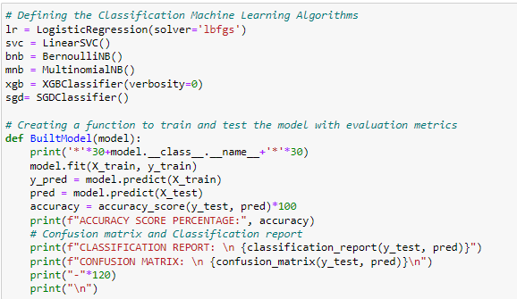

Algorithms Testing

Slide 21
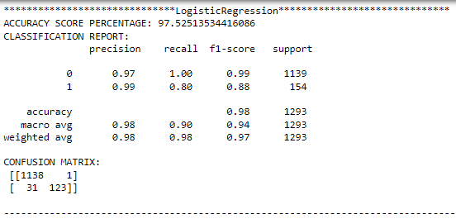
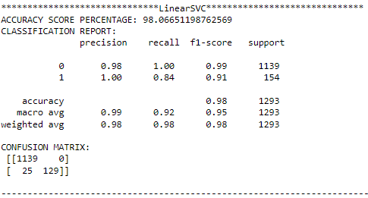
Algorithms Testing

Slide 22
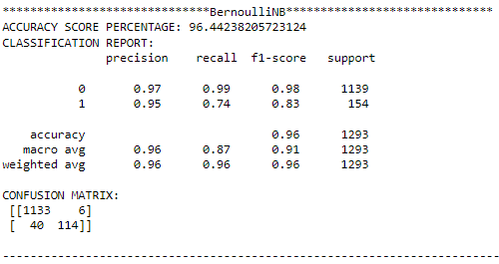
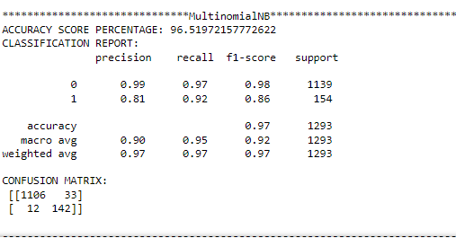
Algorithms Testing

Slide 23
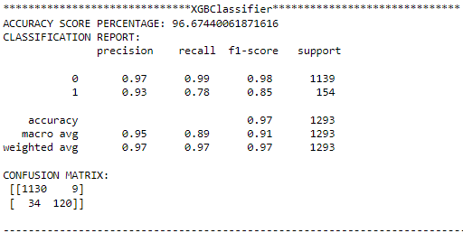
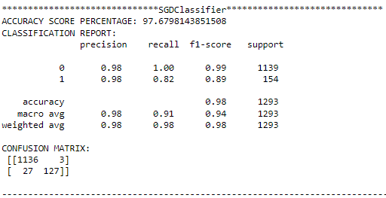
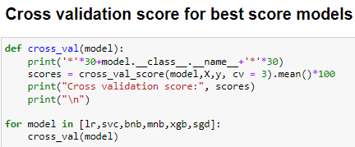
Algorithms Testing

Slide 24
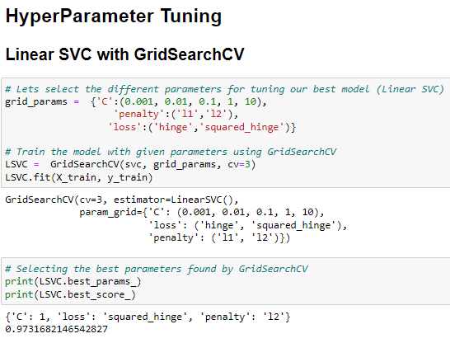
Hyper Parameter Tunning

Slide 25
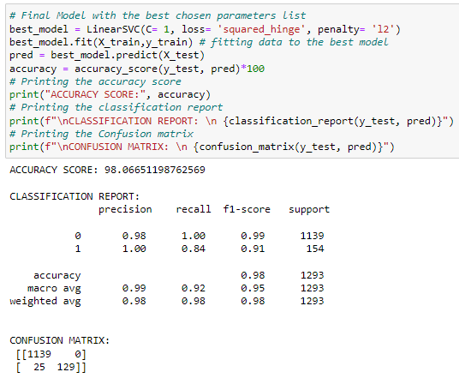
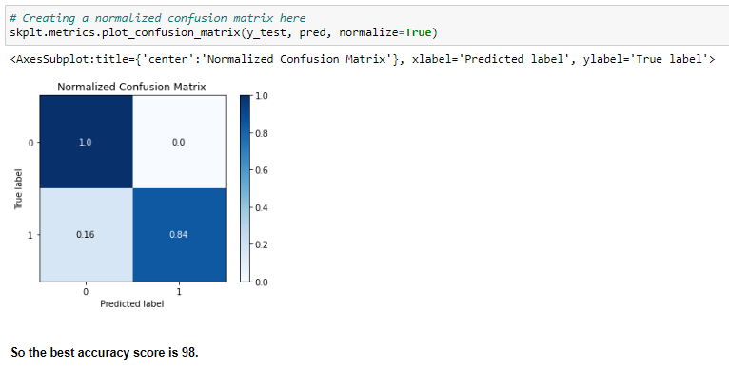
Hyper Parameter Tunning

Slide 26

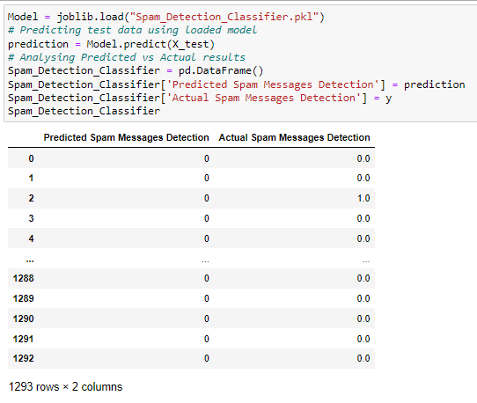
Final Steps
Saving the Model
Comparing Actual & Prediction

Slide 27

Saving model in CSV format

Slide 28
Summary
In this project we have detected spam and ham messages that have been collected for SMS Spam research. Then we have done different text process to eliminate problem of imbalance. By doing different EDA steps we have analyzed the text.
We have checked frequently occurring words in our data as well as rarely occurring words. After all these steps we have built function to train and test different algorithms and using various evaluation metrics we have selected Linear-SVC for our final model.
Finally, by doing hyperparameter tuning we got optimum parameters for our final model. And finally, we got improved accuracy score for our final model.

